Slide 1


Slide 2
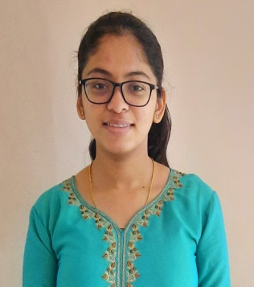
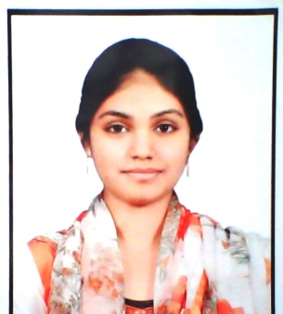
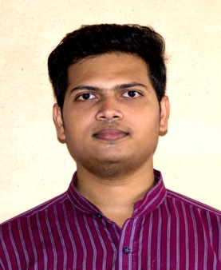
Project Highlights
Project Name : McDonald’s
Team Size : 3
BU Mentor Name : Mentor PS#
Team Members Details (Professional Stamp Size Photo with few lines of individual briefing
ANJALI N MENON
PS99002446
2009MYSSPSB1
Information Science
C, C++,Mysql, CSS
Safura Zohareen PS99002474
2009MYSSPSB1
Information Science
C, C#, html, bootstrap, css MYSQL
SK MD Sohel
PS99002491
2009MYSSPSB1
Mtech CSE
CPP, C, PYTHON, C#

Slide 3
Project Video Snippet

Slide 4
Future development that can be implemented further
To improve user interface.
To add features like place order on clicking menu item.
To add online payment options
To add order delivery tracking

Slide 5


Thank You !

